Slide 1


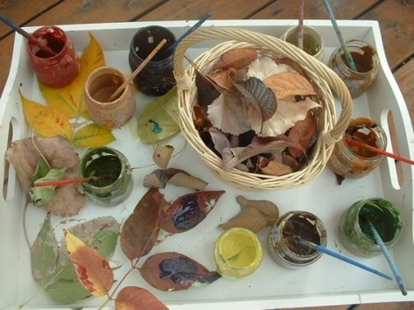
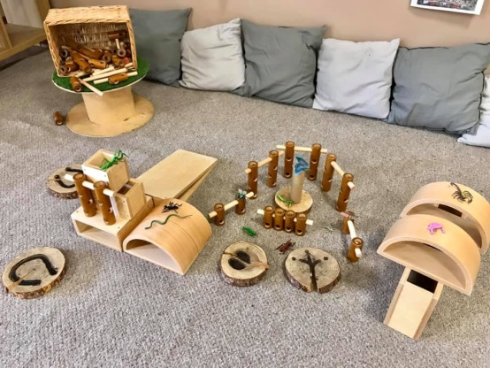
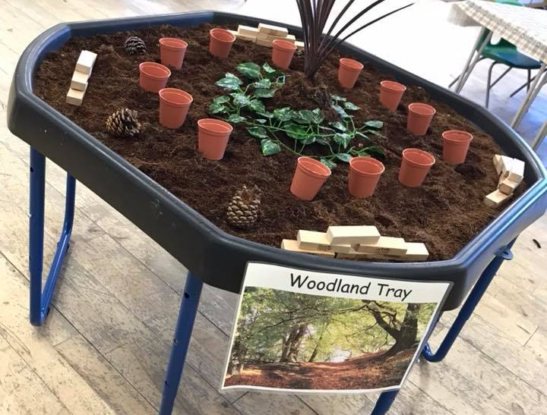

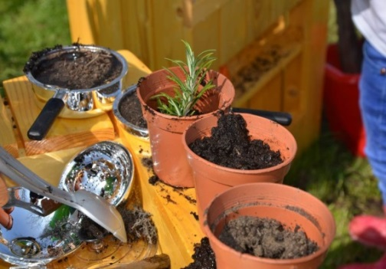
Our Ethos
1. We strive to provide a warm, natural, home from home environment
We do this by creating a beautiful, engaging and stimulating setting for our children. We use lots of natural colours, textures and themes inside, as well as encouraging lots of outdoor play. You won’t find any distracting, garish colours in our nursery, we love muted tones and tactile sensory resources which our children love to explore.
2. We appreciate that every child is unique, and encourage, respect and celebrate individuality
We achieve this by forming strong working partnerships with our families and listening to the opinions and wishes of all our parents/carers and children. We champion an inclusive learning environment and will support the differing needs of our children and families. We encourage all of our families to share with us their unique cultures and traditions whilst striving to foster a sense of belonging and community in all of our children.
3. We believe in genuine child led play, where children have freedom of choice and self-expression
Of course we are there to support, guide and encourage our children, but we think that children learn best when given an environment in which they can choose, try and learn for themselves. This builds confidence, promotes independence and enables them to become self-motivated learners – helping them to achieve their very best.
4. We are huge advocates of a healthy early years, ensuring the best start possible for all children
We understand that as early years practitioners we have an integral role in shaping the choices our children make around health and well-being. We aim to help build strong foundations with regard to healthy eating and physical activity which will benefit our children both now and later in life. As such we will be providing free healthy snacks to all of our children.
5. We believe that children learn best and thrive when having fun
When children are having fun, learning comes naturally and easy. Children are much more likely to remember their experiences and this learning will stay with them as they develop and grow. When children enjoy their play this promotes a healthy desire to learn both now and later in life.

Slide 2
Sessions
At Treetops Nursery Hethersett we appreciate the need for flexible, high quality childcare. As such, unlike many other nurseries we offer a variety of drop off and collection times. This means our parents/carers can access between 3 and 8 hours of childcare per day, choosing bespoke childcare options to meet their individual needs.
We ask that whatever your contracted drop off and collection time, you are ready for when the nursery doors open. This means that drop off and collection times run smoothly for children, parents and staff alike.
Fees
We accept Government funding for children aged 3 and 4 years. All children are eligible for 15 hours of free childcare from the term following their 3rd birthday, up until they start school. For some working families this increases to 30 hours, you can find out more information here https://www.norfolk.gov.uk/children-and-families/childcare-and-early-learning/free-childcare-and-learning/free-childcare-for-working-parents-of-3-and-4-year-olds.
Some 2 year olds are also eligible for 15 hours of funding per week, depending on family income. For more information on 2 year funding please see www.norfolk.gov.uk/children-and-families/childcare-and-early-learning or contact us on 07943 443 270 or at Treetopsnurseryhethersett@hotmail.com.
Parents/carers are also able to pay the nursery directly for sessions at a cost of £4.50 per hour. Fees are paid each half term by either cash or bank transfer and we also accept employer childcare vouchers and tax free childcare.
We would like to remind you that if you are away your place still has to be paid for as we have set costs which need to be covered. Also, if you choose to leave Treetops Nursery we require a minimum of one months’ notice, fully paid.
Consumables
We have a voluntary consumables charge which is 50p per session. This is a voluntary payment which helps us to ensure we can offer outstanding activities every day throughout our nurseries & covers every day items such as snack, wipes, cleaning materials etc.
Key person
When your child comes to Treetops Nursery they will be allocated a ‘Key person’. This is a member of staff who will be in the majority, if not all of your child’s sessions. They will be your main point of contact during your child’s time with us and will oversee your child’s individual needs and learning journey.
Snacks and lunch
We provide a healthy snack of fruit and raw vegetables for all our children mid-morning. Children who are present during the afternoon session will also need to bring a healthy packed lunch from home, which is usually eaten around 12:15pm. Children will also need to bring a named water bottle with them to nursery.
Uniform
Our uniform is not compulsory, although we do find it helps our children to feel part of the nursery community. We have t-shirts and sweatshirts available to order, and these are priced at £7.50 and £10. There are also an array of different items for sale in our online shop found on our website with a full list of pricings. Order form attached
Next steps
If you would like your child to join us at Treetops Nursery Hethersett, please complete the attached forms and email them to treetopsnurseryhethersett@hotmail.com at your earliest convenience or print and hand into Hethersett VC Primary School Reception . Once we have received your forms we will be in touch to officially offer you a place and provide you with further information relating to your child’s start with us.
Please do not hesitate to contact Andrew on 07943 443 270 or via email at Treetopsnurseryhethersett@hotmail.com if you have any queries.
Our drop off times: 8:00am 8:30am 9:00am 12:00pm | Our collection times: 12:00pm 3:00pm 3:30pm 4:00pm

Slide 3


Please tick if 2 year funded
Child’s full name
Date of birth
Gender
Preferred start date
Religion/ethnicity
Home language/s
Postcode
Home address
Names of other settings attended
Other professionals involved | Dietician / Speech&Language / Optician / Hearing / Physio / Social Services / ASD Support Paediatrician / Family Support Worker / Occupational Therapy / Early Help / Portage / OTHER
CARER 1 DETAILS
Name:____________________________________
Relationship to child:________________________
Parental responsibility? YES / NO
Address (if different):________________________ _________________________________________
Home tel. no.:______________________________
Work tel. no.:______________________________
Mobile tel. no.:_____________________________
Email:____________________________________
CARER 2 DETAILS
Name:____________________________________
Relationship to child:________________________
Parental responsibility? YES / NO
Address (if different):________________________ _________________________________________
Home tel. no.:______________________________
Work tel. no.:_______________________________
Mobile tel. no.:_____________________________
Email:_____________________________________
3rd Emergency contact name
3rd Emergency contact tel. no.
3rd Emergency contact relationship
Doctor’s name
Doctor’s surgery address
Doctor’s surgery tel. no.
Dietary requirements
Medical conditions
Immunisations up to date?
Special educational needs
Parent/carer signature: Date:
I understand it is my responsibility to inform you of any changes to the above information

Slide 4
Child’s full name |  | Date of birth
Please complete the below so we know which sessions you would like.
For each day that you would like your child to attend, please put one tick in a blue start time box, and one tick in a green finish time box
Monday | Start time |  | Finish time
 | 8:00am |  | 12:00pm
 | 8:30am |  | 3:00pm
 | 9:00am |  | 3:30pm
 | 12:00pm |  | 4:00pm
Tuesday | Start time |  | Finish time
 | 8:00am |  | 12:00pm
 | 8:30am |  | 3:00pm
 | 9:00am |  | 3:30pm
 | 12:00pm |  | 4:00pm
Wednesday | Start time |  | Finish time
 | 8:00am |  | 12:00pm
 | 8:30am |  | 3:00pm
 | 9:00am |  | 3:30pm
 | 12:00pm |  | 4:00pm
Thursday | Start time |  | Finish time
 | 8:00am |  | 12:00pm
 | 8:30am |  | 3:00pm
 | 9:00am |  | 3:30pm
 | 12:00pm |  | 4:00pm
Friday | Start time |  | Finish time
 | 8:00am |  | 12:00pm
 | 8:30am |  | 3:00pm
 | 9:00am |  | 3:30pm
 | 12:00pm |  | 4:00pm

Slide 5


Child’s full name
Date of birth
Permissions | Yes | No
I agree to my child’s development being reviewed and documented within their online learning journey
I give permission for my child’s photo to be used in their own learning journey
I give permission for my child’s photo to appear in the learning journeys of other children
I consent to my child’s photo being used in classroom displays, on Facebook and the Nursery Website
I give permission for staff to apply sun cream to my child and I agree to provide a sun hat in the warmer months. I understand that if I do not, my child may be unable to play outside
I give permission for staff to take my child on local outings, following the guidelines for lower ratios (you will be informed at drop off if we plan to take the children on a local outing that day)
I give permission for staff qualified in first aid to administer first aid in my absence and for my child to have first aid assistance administered by others when you deem necessary e.g. a paramedic
I give permission for a qualified first aider to use non-alcohol wipes and plasters on my child
I agree to you sharing my child’s information with other settings they may attend to ensure continuity of care and to support my child’s learning and development
I give consent for you to discuss my child and share my child ‘s information with other professionals and outside agencies such as Ofsted, the NHS, SureStart Centre and Norfolk County Council where this will help to improve the quality of care provided by the setting and support my child’s learning and development
Terms and conditions
I consent to our family’s data being held and used by Treetops Nursery for purposes relating to my child’s care
I understand it is my responsibility to inform you straight away of any changes to mine or my child’s details
I am aware of and understand the policies of Treetops Nursery and agree to abide by these at all times (Treetops Nursery’s policies can be found in the nursery foyer or on our website - www.treetopsnursery.org)
I understand that fees (where applicable) are payable half termly, and that late payments are charged at £5 per day on sums remaining due and outstanding
I am aware that if my child is absent their place at Treetops Nursery will still have to be paid for in full
I understand that if we choose to leave Treetops Nursery we are required to give a minimum of one months’ written notice, fully paid
I am aware that Treetops Nursery has the right to make an additional charge for late collection and that the charge for this is £12 per 15 minute period or part thereof
Parent/carer signature:____________________________________________________
Agreement date:__________________________________________________________

Slide 6

Child’s full name
Date of birth
When completing the below, please ensure that you include the
emergency contact from your child record form
Name of person authorised to collect | Relationship to child | Physical description of person – sex, height, hair colour etc. or photo
Please choose a collection password for your child and write this in the space below
My collection password is ___________________________
Please ensure that all those authorised to collect your child know your password

Slide 7
Uniform Order Form
Child’s full name
Date of birth
Please complete the below form if you wish to pre order your uniform.
Item | Size (3-4 or 5-6) | How many?
T – shirts (£7.50)
Jumpers (£10.00)
Racksack (£15.00 | One size fits all
Hat – Cap style (£10.00) | One size fits all
Once we have received your Uniform Order Form we will get this bundled up for you, we will contact you when its ready to collect from the Nursery – You may pay cash on collection
If you wish to see what the above items look like then please visit our website www.treetopsnursery.org

