Slide 1
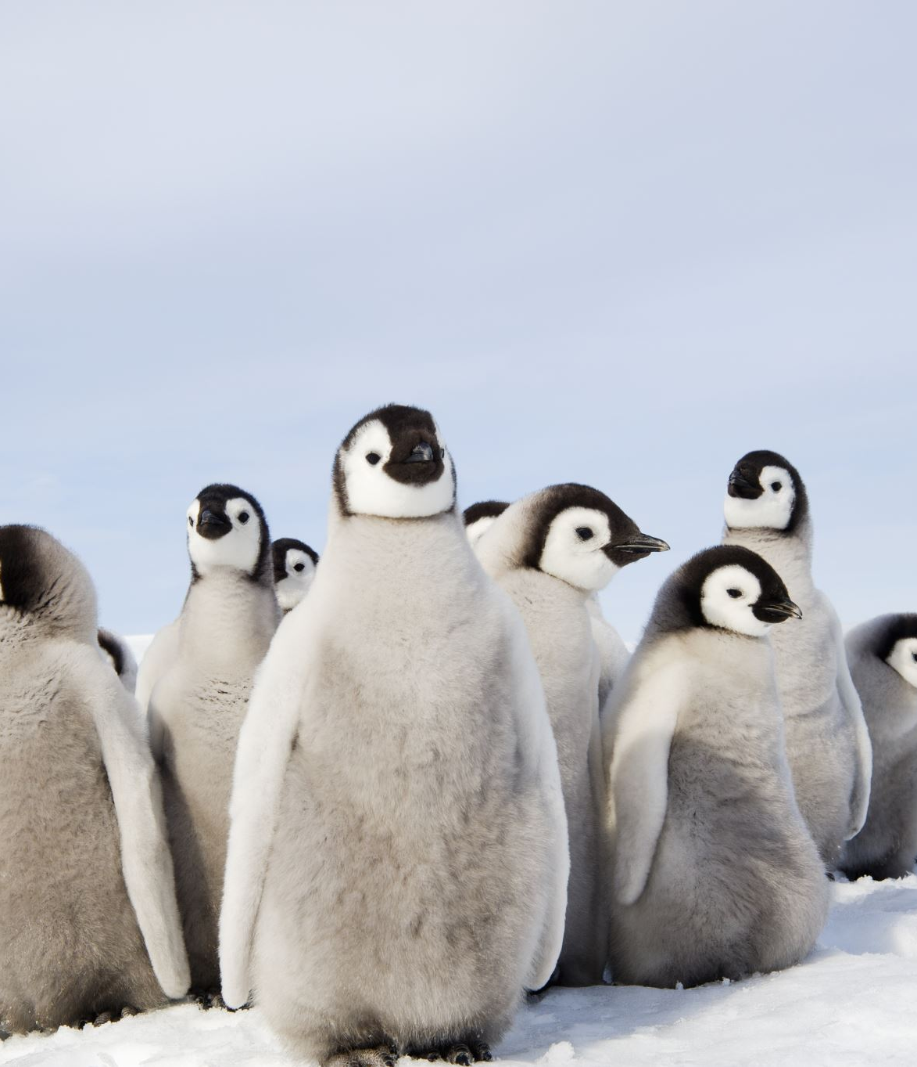
Welcome to Year 2!

Slide 2
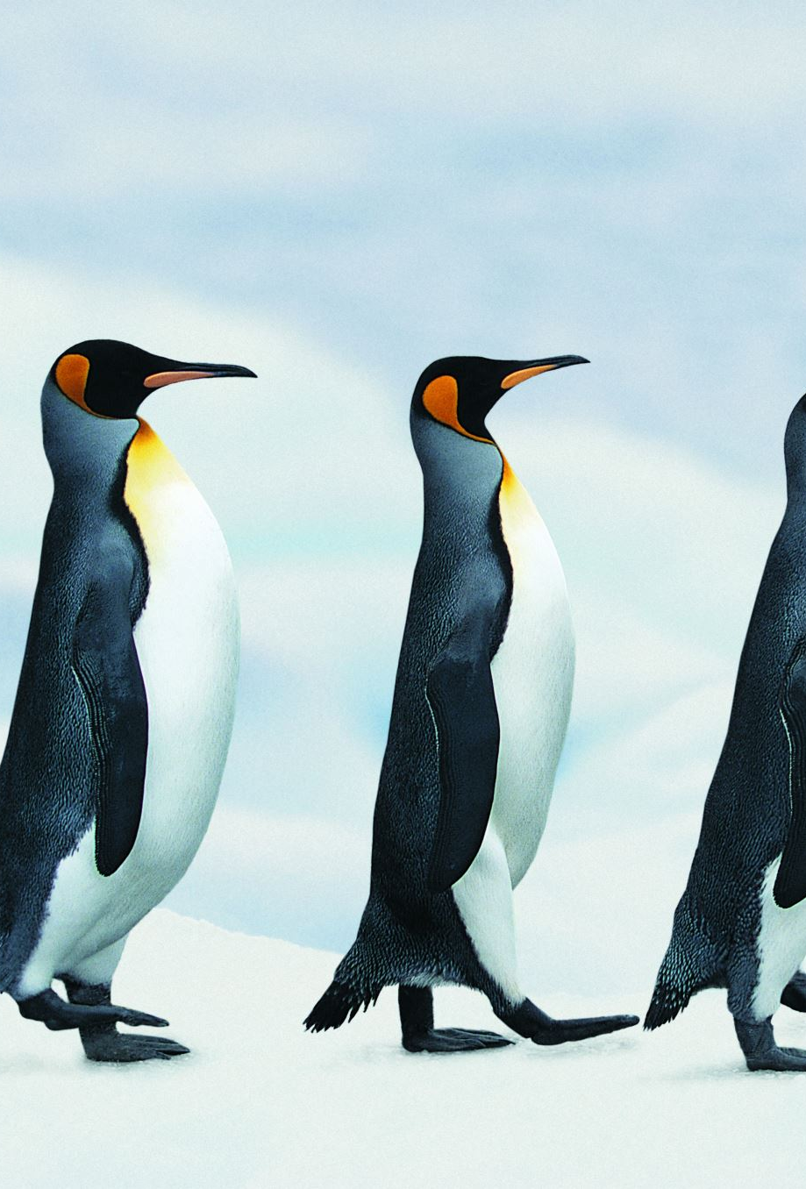
Adults who work in Penguin Class are:
Mrs Cooper (Class teacher – Monday, Tuesday and Wednesday)
Mrs Simons (Class teacher – Thursday and Friday)

Slide 3
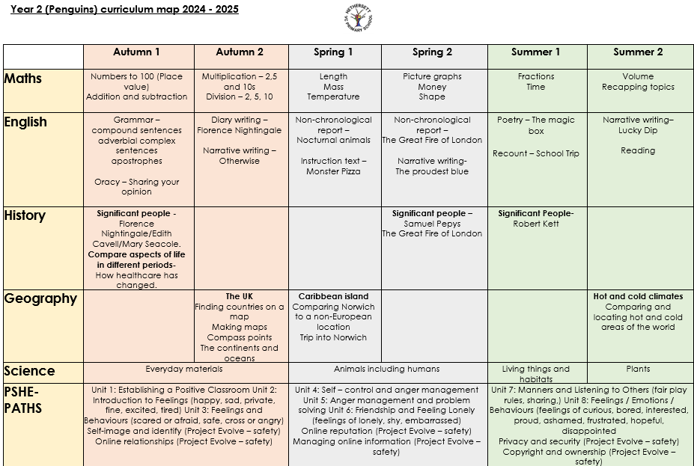

Slide 4
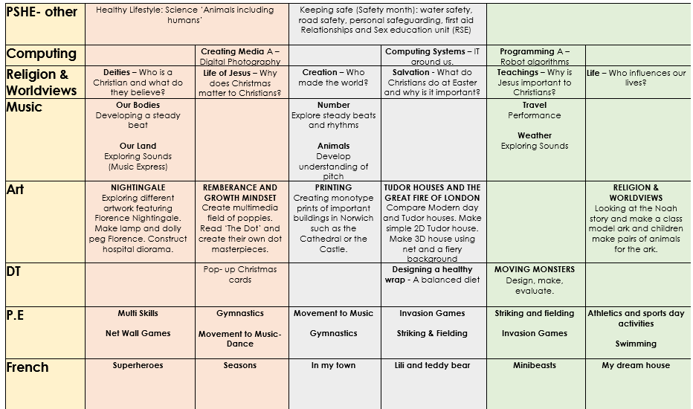

Slide 5
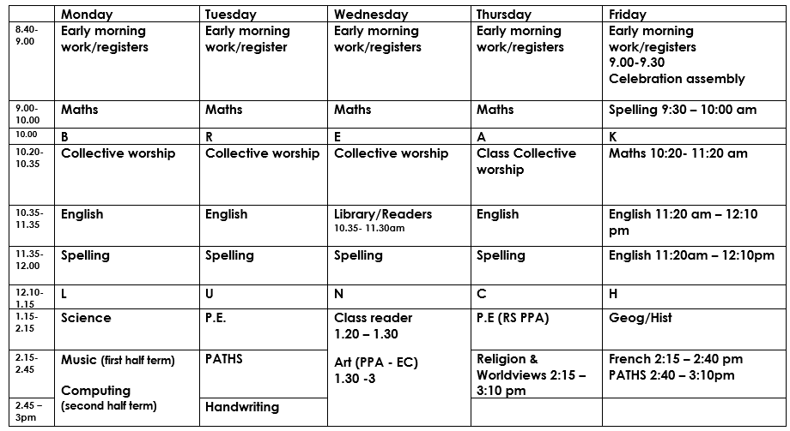
Class Timetable for Autumn:

Slide 6
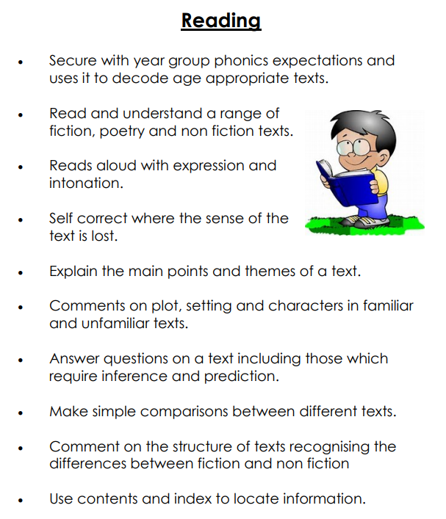
Expectations for the end of the year:

Slide 7
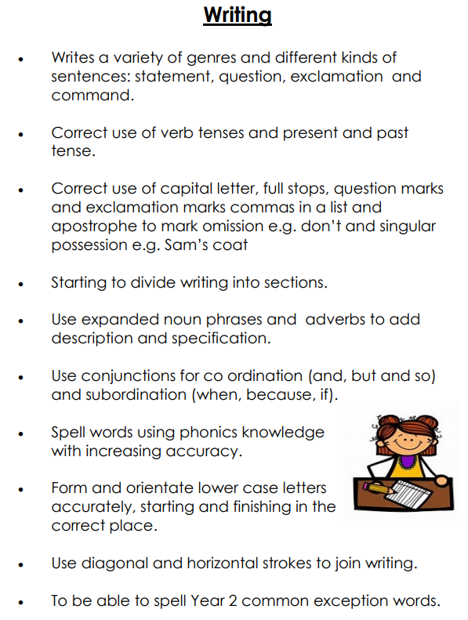
Expectations for the end of the year:

Slide 8
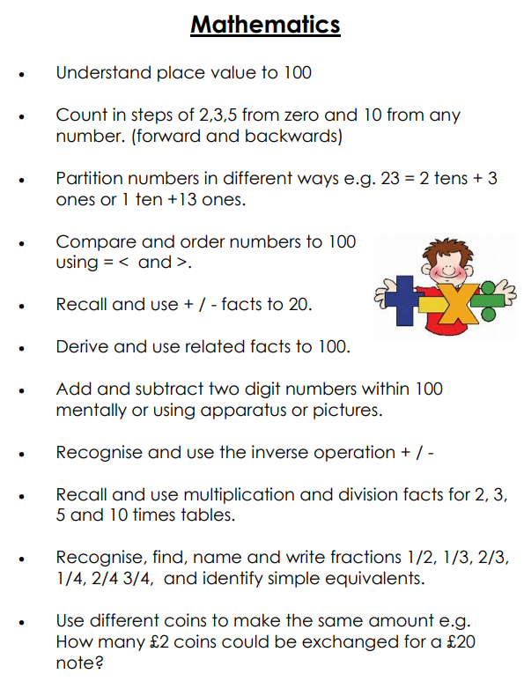
Expectations for the end of the year:

Slide 9


How can you help at home?
Homework expectations are:
Maths: Continue to work on . Later on in the year this will become
Reading: Reading at home as regularly as you can. Please record reading in the reading log. 3 reads = 1 house point; 4/5 reads = 2 house points and 6+ reads = 3 house points.
Phonics: There will be weekly spellings to practice that will complement the phonics your child has been learning during the week.
Half termly factfiles – based around our topic for the half term. The first one is focused on History.

Slide 10
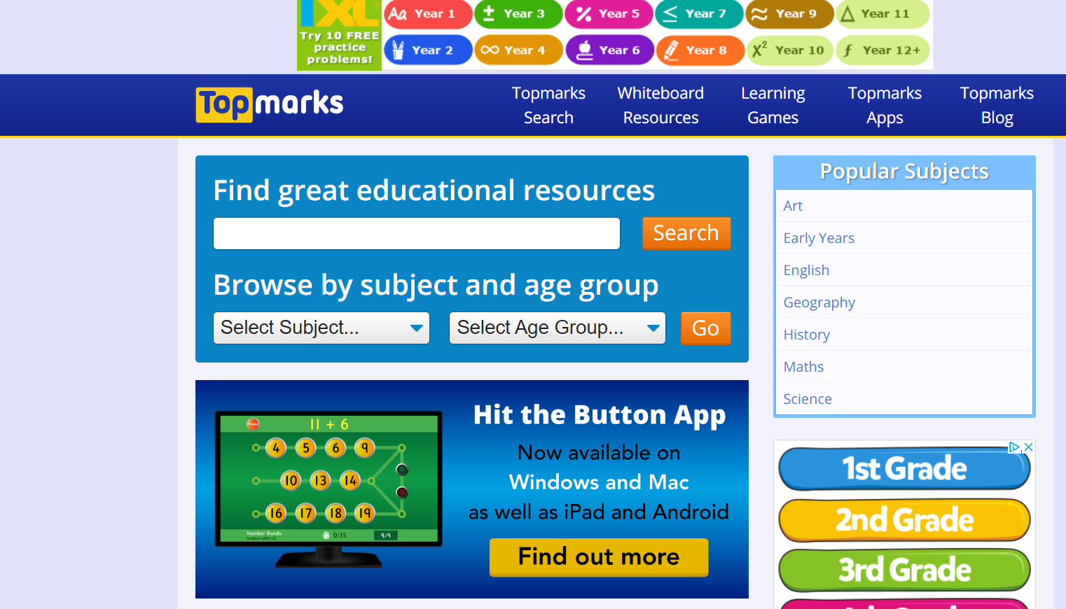
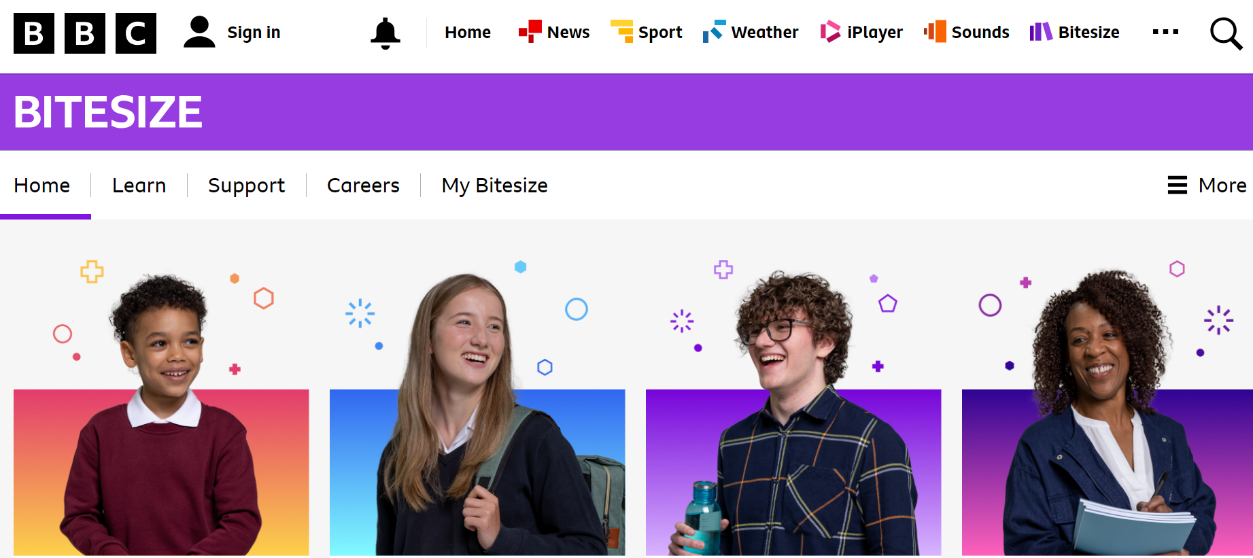
Additional websites to help your child with their learning:
https://www.topmarks.co.uk/
https://www.bbc.co.uk/bitesize

Slide 11
P.E. days are: Tuesdays and Thursdays. Library books will be changed on Wednesday. Reading books will be changed on Friday.

Slide 12
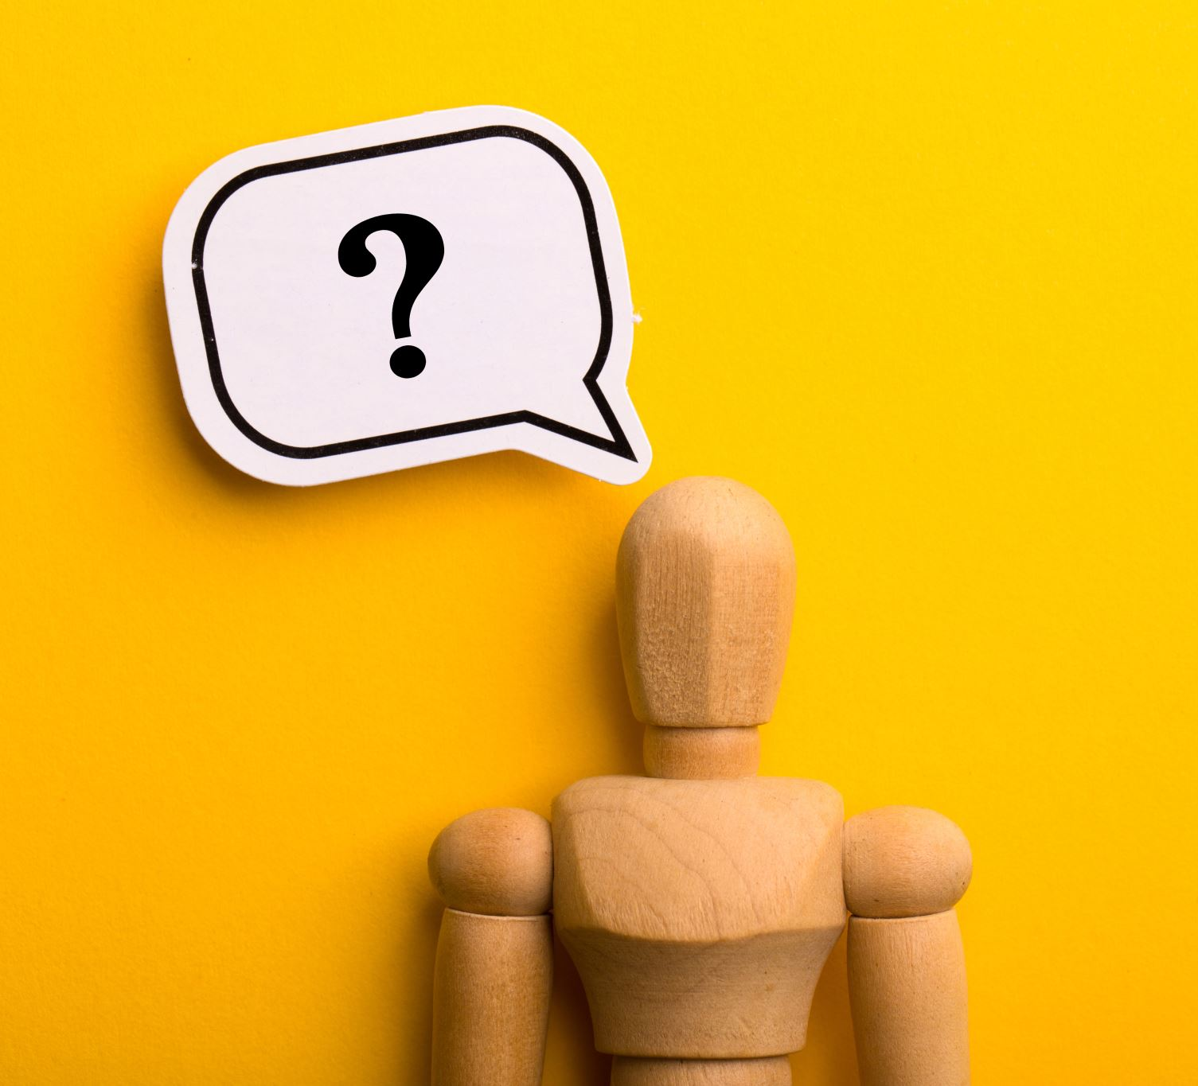
Thank you for coming! Any questions?

